Slide 1
Criterion 3: The school must demonstrate how they will continue to develop and sustain a culture of welcome beyond the award. Ideally this should be linked to the school’s improvement plan and made clear in policy documents.
As part of evaluation and improvement cycle, we have embedded SOS and wider sanctuary (culture of welcome) work into termly and annual review. We address improvements in these areas under the Estyn headings but have included our ongoing work with sanctuary to be included within ‘Whole School Approach..’. also.
This means, that as part of the dashboards posted through school and on our website, SOS is overt and ever present. As the following slides show, facets of sanctuary work are ever evolving and evaluated….
Notes:
Consider:
Admissions/ First Day processes
EAL
Wellbeing/Mental Health/Trauma-informed Practice
Sustainable structures (i.e. is there an EAL/Sanctuary Lead? Do you have written policies? Are ‘sanctuary themes’ included in regular staff/SLT/governor meetings and/or do you have an annual review?

Slide 2
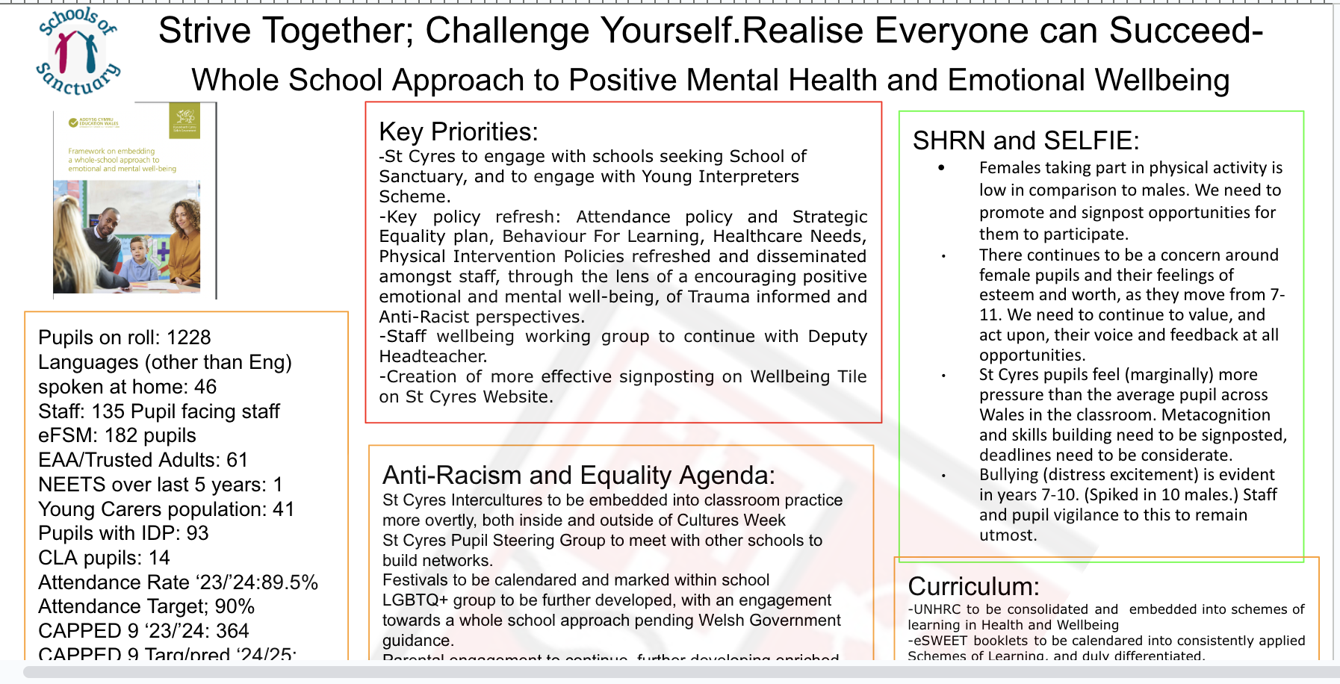
Dashboards are present throughout school…

Slide 3

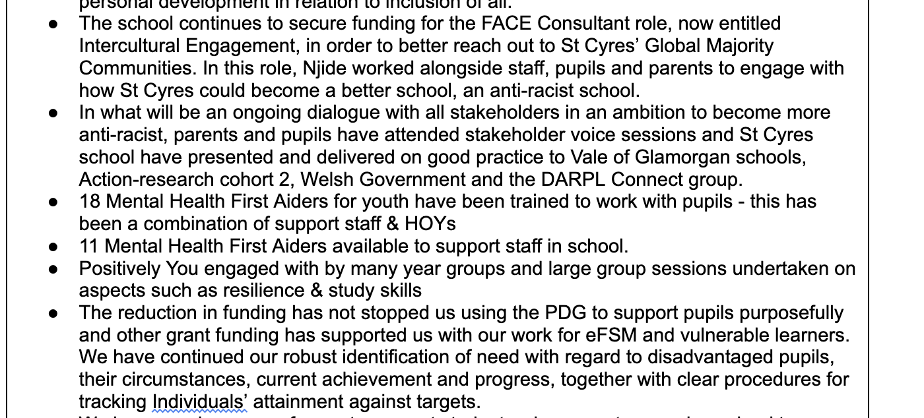
Screenshots from self-evaluation under ‘Care, Support and Guidance” and now “Care, Support and Wellbeing”

Slide 4
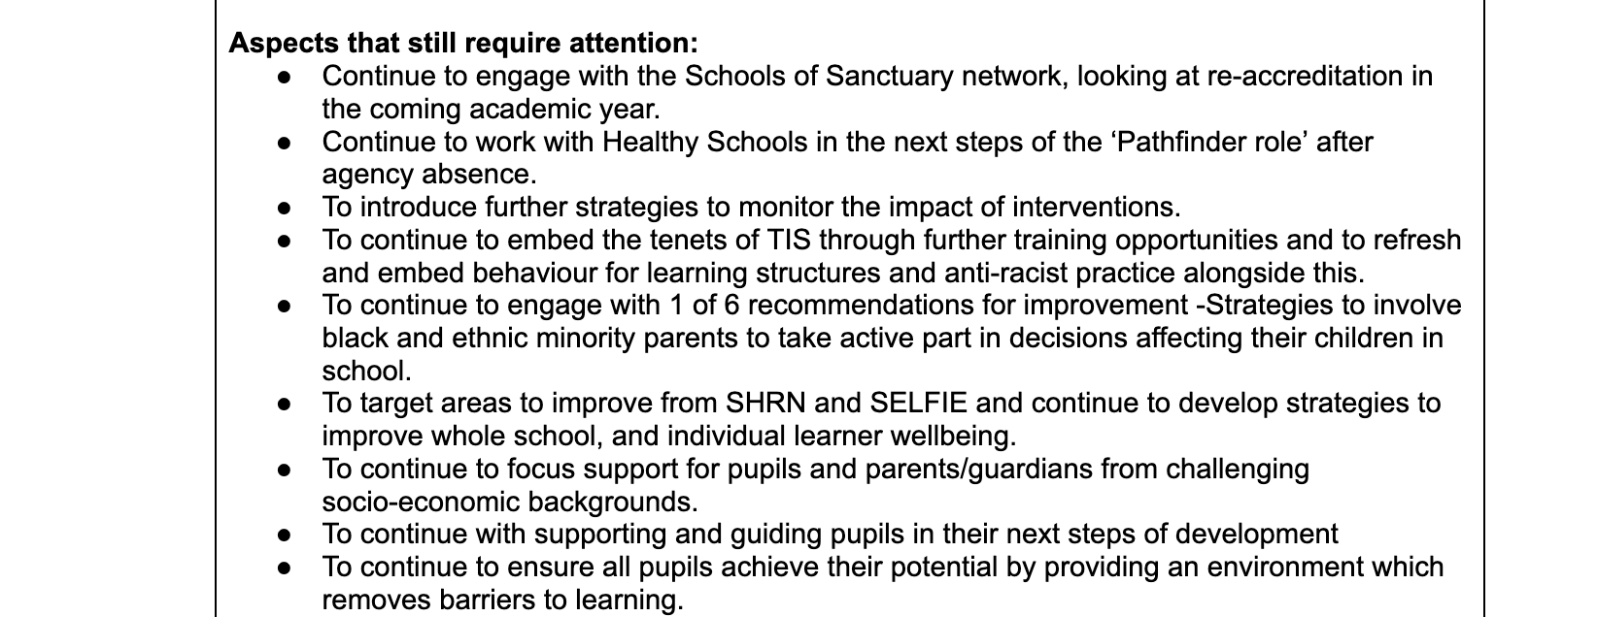
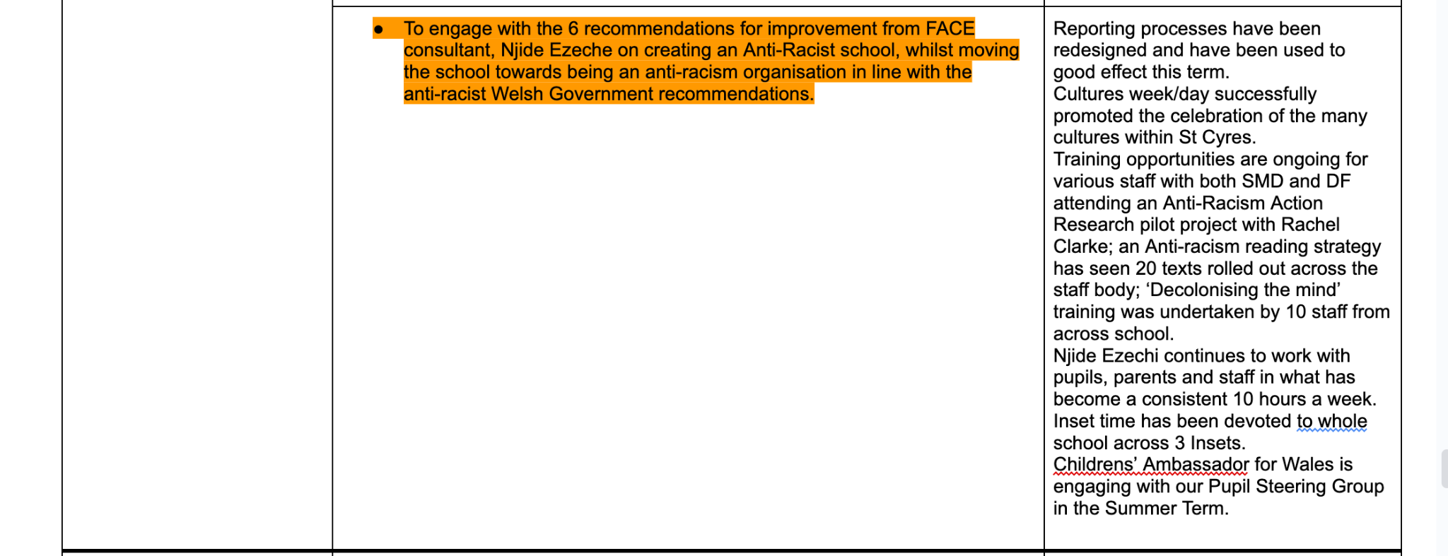
Screenshots from self-evaluation under ‘Care, Support and Guidance” and now “Care, Support and Wellbeing”

Slide 5
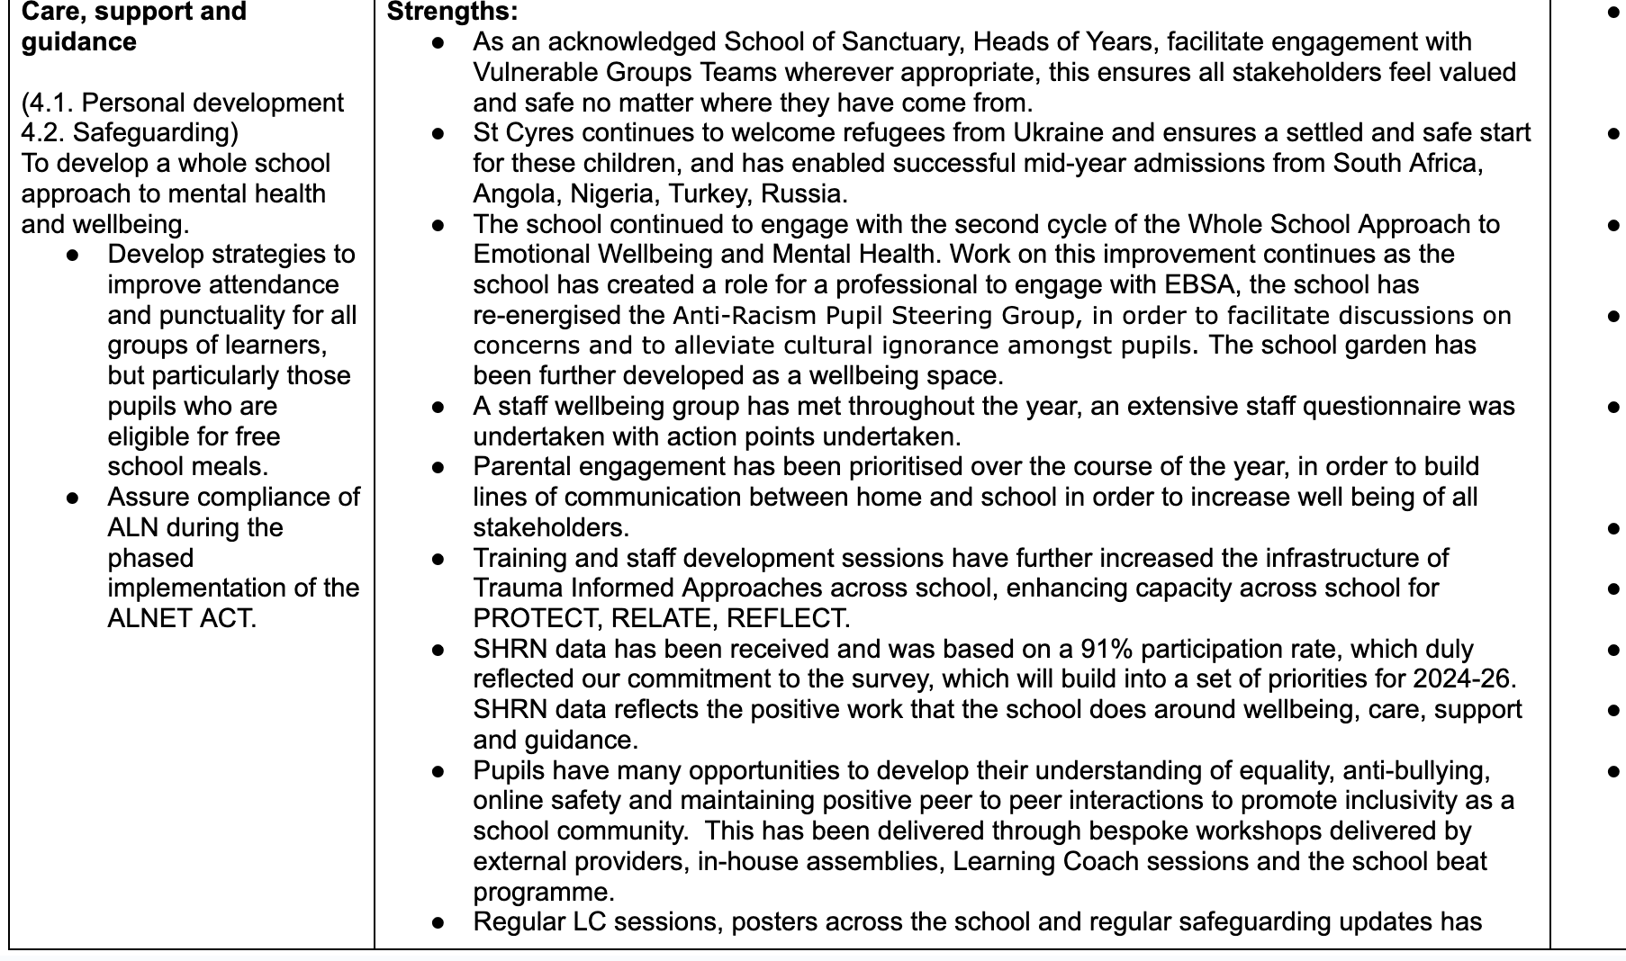
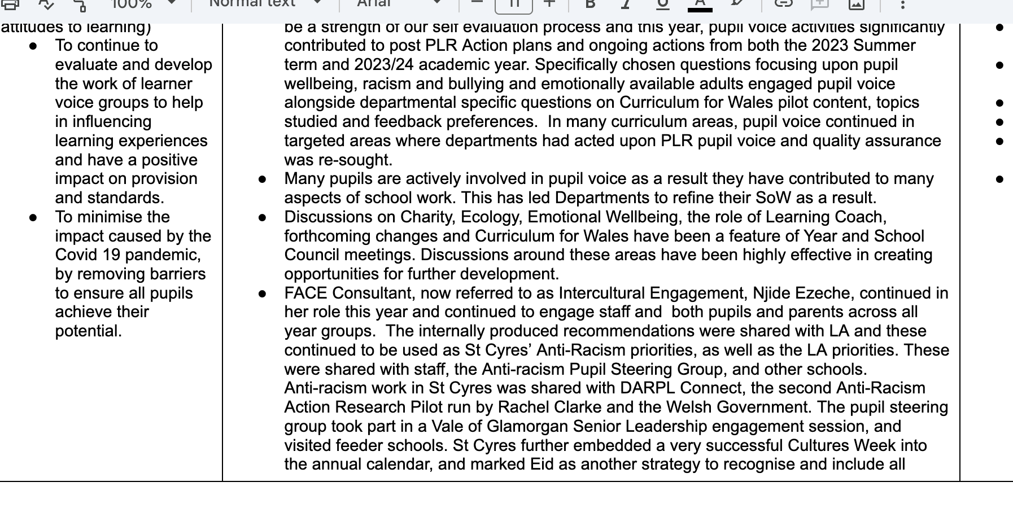
Screenshots from self-evaluation under ‘Care, Support and Guidance” and now “Care, Support and Wellbeing”

Slide 6
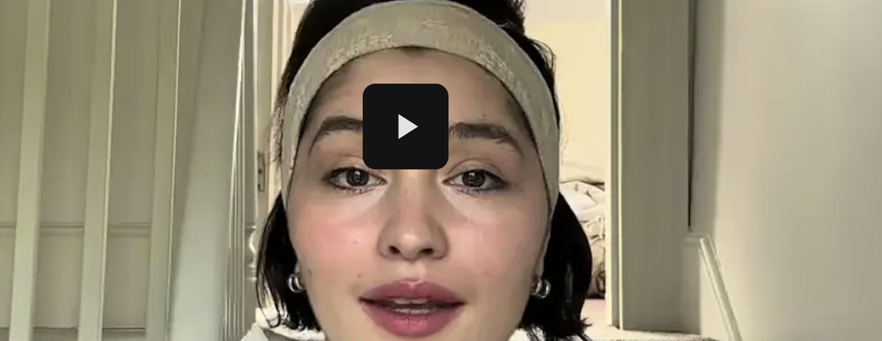

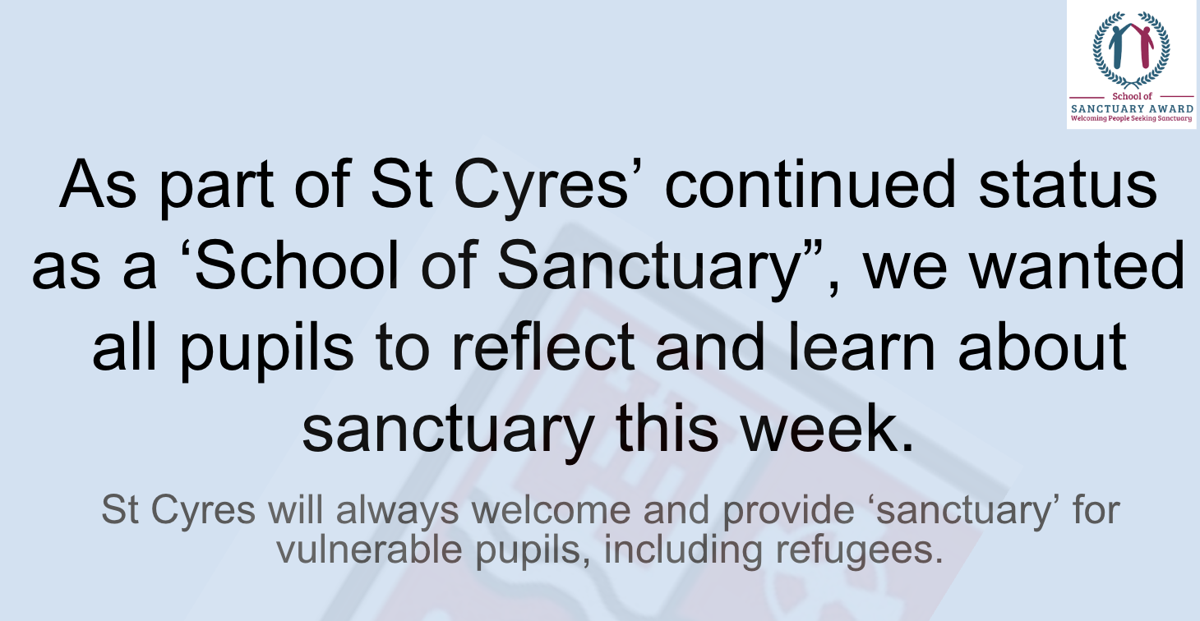
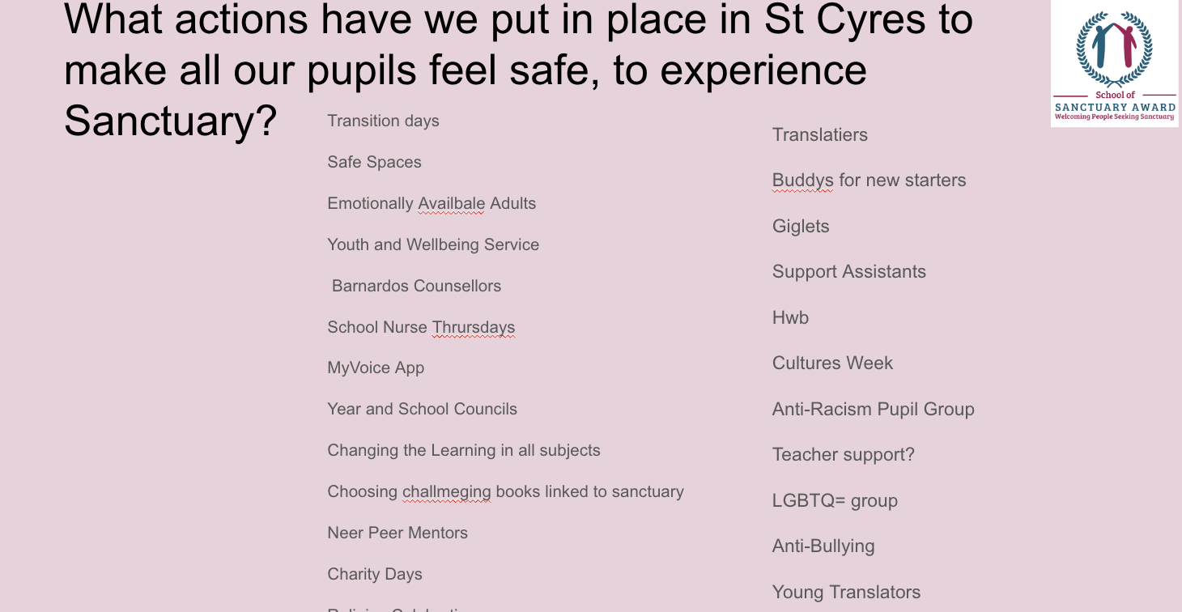
Criterion 4: Recognition of and participation in the annual Refugee Week or other regular celebratory events which highlight the contribution of refugees and migrants to the UK
Please see range of images from variety of lessons in initial slides. For refugee week this year we showed “Geranium” across all year groups as part of 3 sessions and encouraged the “Thunderclap” alongside prudent discussions around AI Fakery and controversial and incorrectly held anti-sanctuary idealogy.
Notes:
Consider:
your plans for last /coming Refugee Week - what did you do and how did you make it meaningful?
other relevant celebrations (if time allows)

