Slide 1


Revision Tips for Pupils with ALN

Slide 2
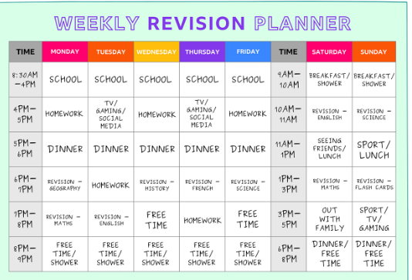
Create a revision timetable
Break the day up and allocate a time per day for revision
Try to keep the revision sessions to a limited time (1 hour max)
Surround the revision session with something you know they will enjoy e.g. snack, time on ipad etc

Slide 3
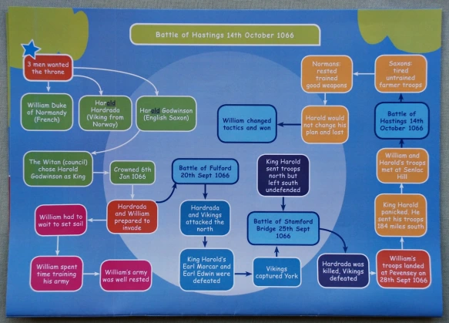
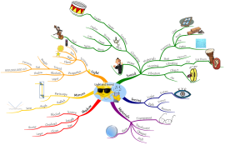
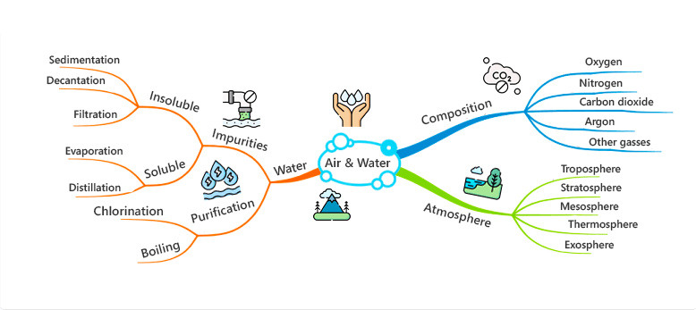
Mind Maps
Lots of children like to learn visually
Encourage your child to create a mind map about a topic

Slide 4

Attend Homework Club
ALN Homework club - Every Wednesday in Learning Support 2:40-3:30

Slide 5

Never underestimate the power of a song
Turning things into songs can be incredibly powerful
E.g. Learn the periodic table

Slide 6

Vocabulary
Check that your son / daughter understand the key vocabulary
Some pupils can say the word, spell it correctly but feel less confident using the word in a sentence
Help support you son / daughter by not just asking them the meaning of the word but how to use that in a sentence.

Slide 7
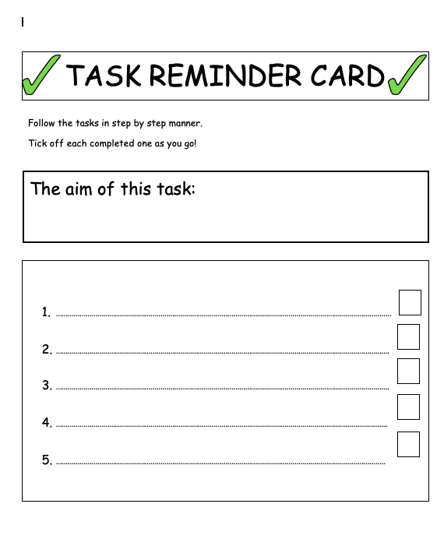
Task Sheets
Help your sons / daughter to organise what they need to do by developing a task sheet for them.
Specify what tasks your expect them to complete
List them in the the order you need them to carry them out
Encourage your son / daughter to tick off the tasks as they complete them.

Slide 8
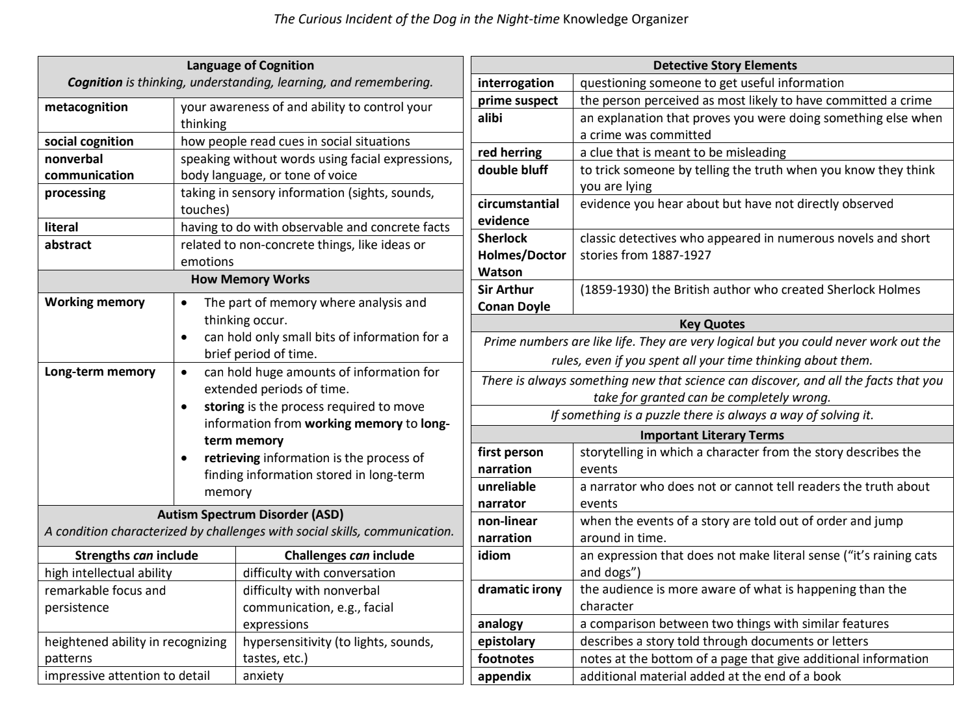
Knowledge Organisers
Help your child to retrieve information from a
knowledge organiser
Put it on the fridge and ask questions
relating to it.
Can your child define the key words?
Can your child use the key word in a sentence?

